Slide 1
CENG - 317
NFC Platform
Marko Javorac

Slide 2
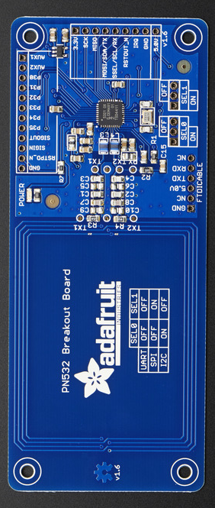
Introduction
Design an NFC reader/writer able of controlling security mechanisms
Adafruit PN532 NFC/RFID
Case/Housing unit

Slide 3
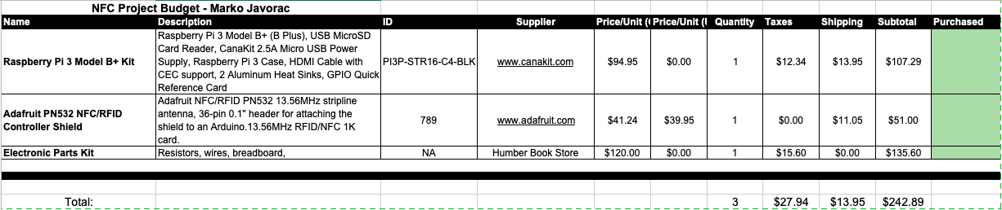
Budget
Low cost
Case, PCB, and header provided by Humber Prototype Lab
Did not exceed budget

Slide 4
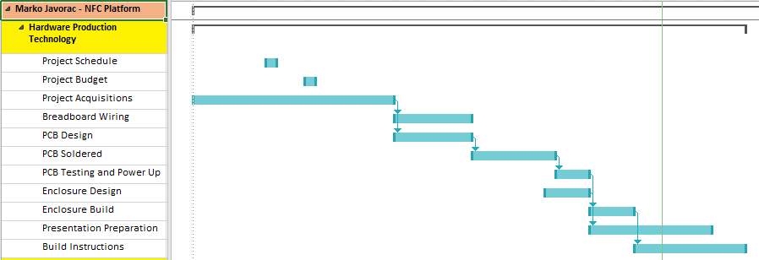
Schedule
Did not stick to it

Slide 5
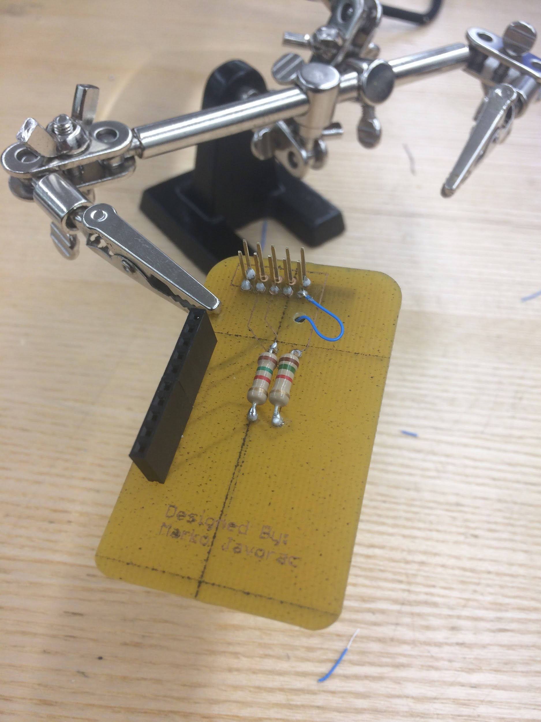
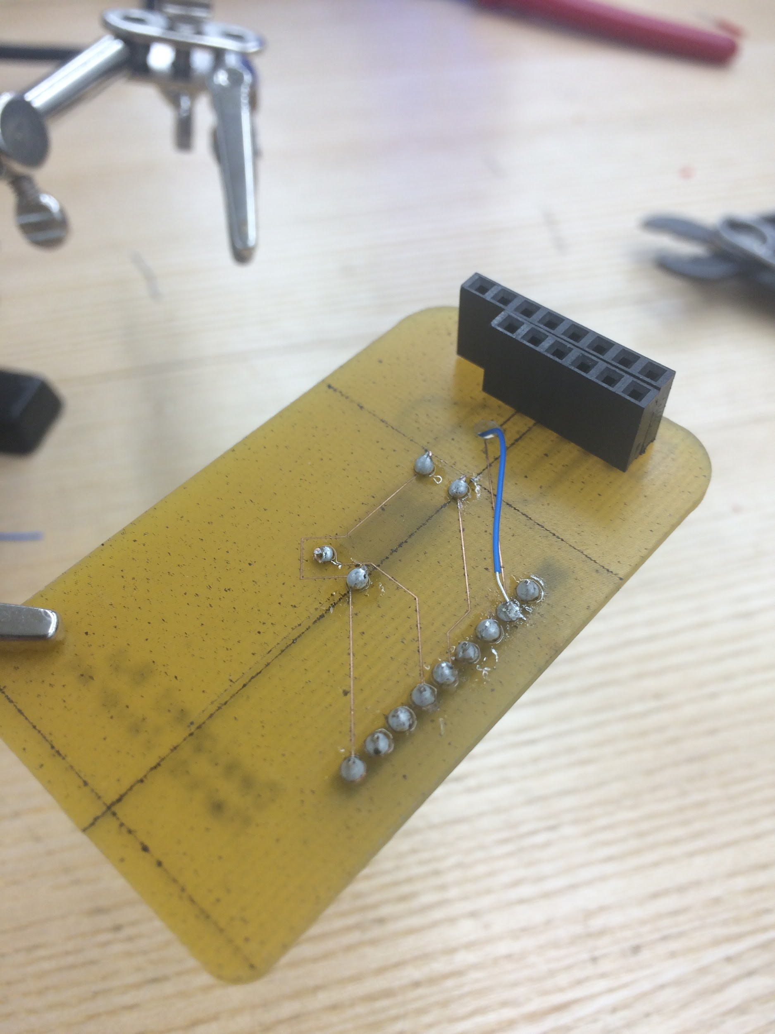
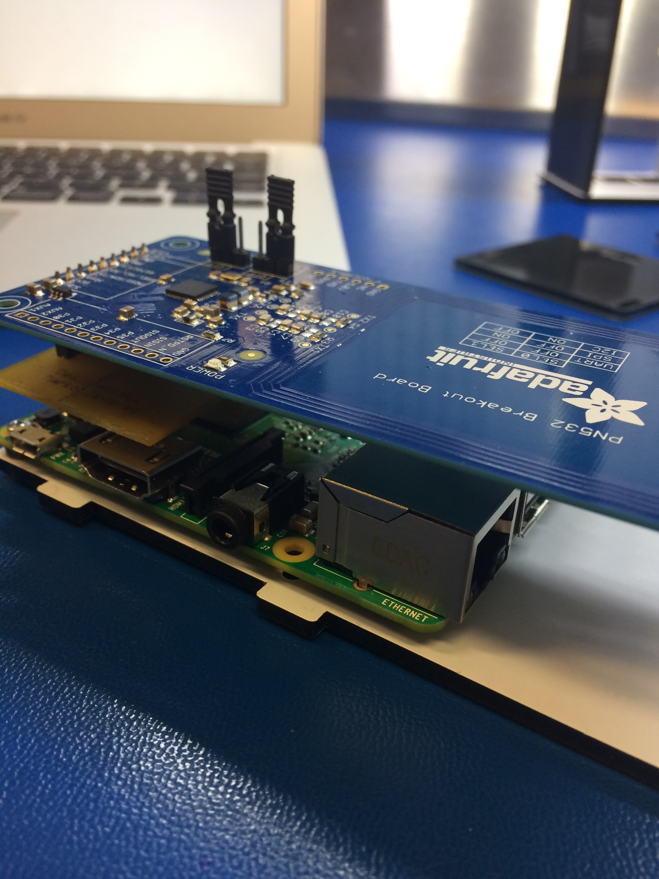
Visuals - Hardware

Slide 6
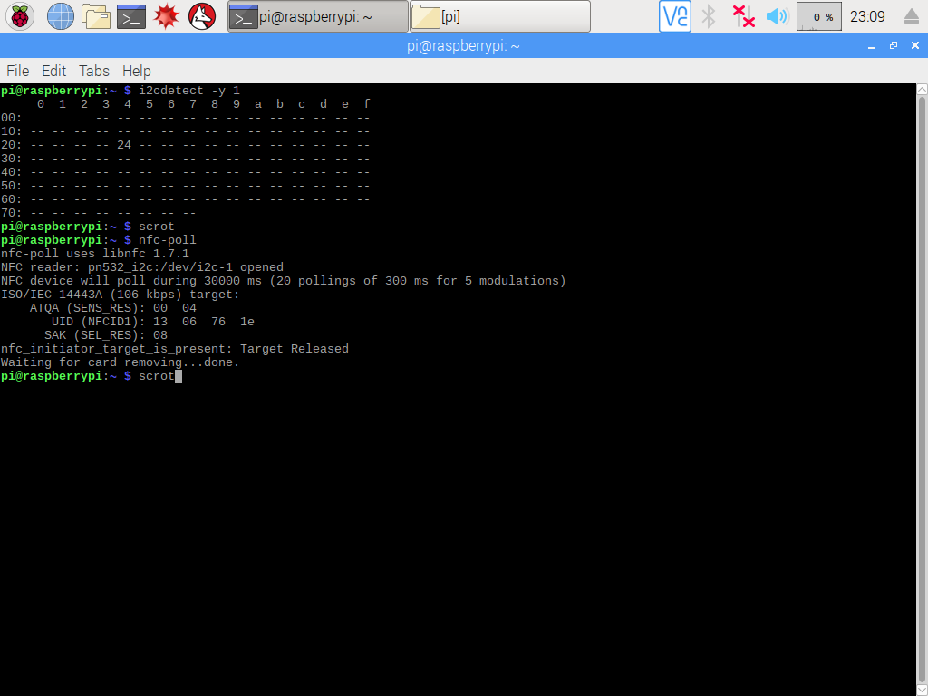
Visuals - Software

Slide 7
What did I learn?
Attach project schedule to life workflow
Allocate extra time for mistakes/errors
Documentation is everything

Slide 8
Thank You!!!

